Slide 1
Manuel Convolution: Image Processing Project
By Cassy Cormier
April 27th, 2025

Slide 2
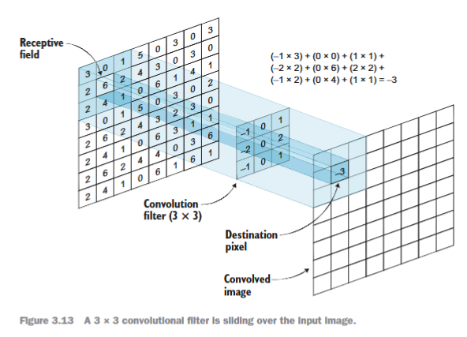
What is Convolution?
In mathematics, a convolution is the operation of two functions to produce a third modified function.
It helps detect edges, corners, patterns, and textures.
Commonly used in computer vision and CNNs.

Slide 3

Manual Convolution Demonstration

Slide 4
Original Image (5x5 Grid)
0 | 0 | 1 | 0 | 0
0 | 0 | 1 | 0 | 0
1 | 1 | 1 | 1 | 1
0 | 0 | 1 | 0 | 0
0 | 0 | 1 | 0 | 0
Cross Shape

Slide 5
Filters Designed
-1 | 0 | 1
-1 | 0 | 1
-1 | 0 | 1
Filters created:
Vertical Edge Detection Filter
Horizontal Edge Detection Filter
Simple Blur Filter
-1 | -1 | -1
0 | 0 | 0
1 | 1 | 1
1 | 1 | 1
1 | 1 | 1
1 | 1 | 1

Slide 6
Convolution Result
2 | 2 | 2
0 | 0 | 0
-2 | -2 | -2
Horizontal Edge Detection Filter Feature Detection Interpretation
High positive values (top row) → Top horizontal edge detected.
Zero values (middle row) → Flat area (no edges).
High negative values (bottom row) → Bottom horizontal edge detected.
Confirmed the cross shape has strong horizontal edges at top and bottom.

Slide 7
Conclusion & takeaways
Manual convolution helps visualize how computers detect patterns.
Filters can be customized for different types of features (edges, textures, etc.).
Important foundation for computer vision models like CNNs.

Slide 8
Thank you
Cassy Cormier
w215492039@student.hccs.edu
Cassy.cormier@icloud.com

